Slide 1
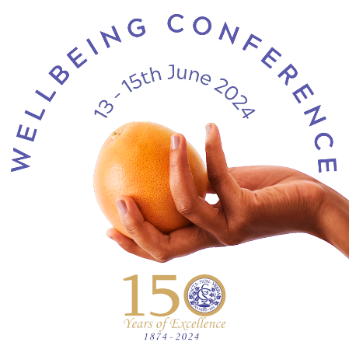
The Power of Positive Education
Playing to what is strong, not what is wrong
Presented by
Kathy Balshaw

Slide 2

Grateful

Slide 3
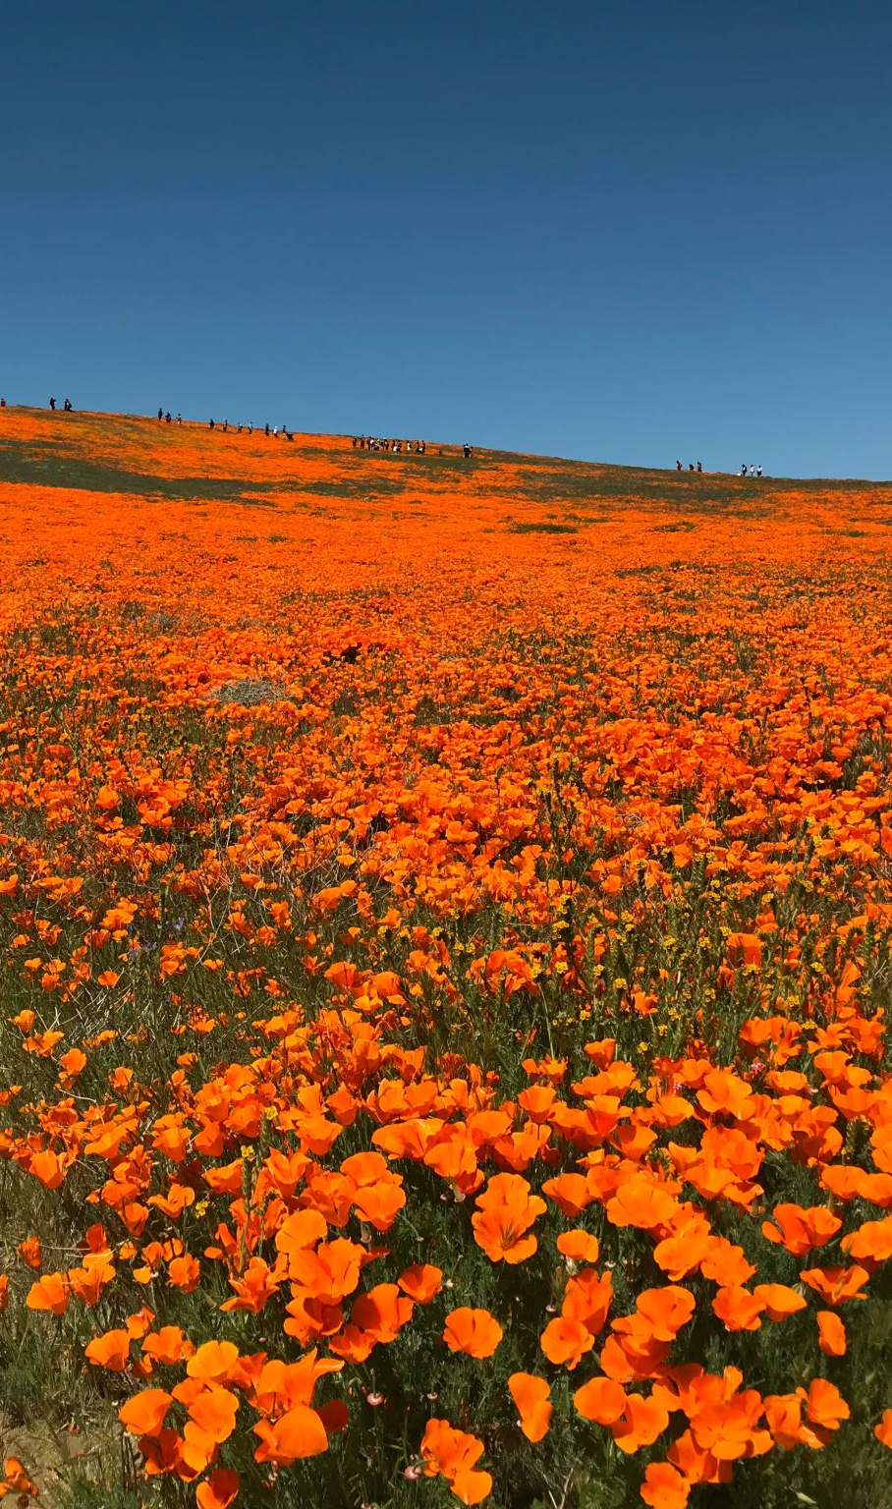

Thankful
Some days we forget
To look around us
Some days we can't see
The joy that surrounds us
So caught up inside ourselves
We take when we should give

Slide 4

So for tonight we pray for
What we know can be
And on this day we hope for
What we still can't see
It's up to us to be the change
And even though we all can still do more
There's so much to be thankful for

Slide 5

Look beyond ourselves
There's so much sorrow
It's way too late to say
I'll cry tomorrow
Each of us must find our truth
It's so long overdue

Slide 6
So for tonight we pray for
What we know can be
And on this day we hope for
What we still can't see
It's up to us to be the change
And even though we all can still do more
There's so much to be thankful for

Slide 7

Even with our differences
There is a place we're all connected
Each of us can find each other's light

Slide 8
So for tonight we pray for
What we know can be
And on this day we hope for
What we still can't see
It's up to us to be the change
And even though this world needs so much more

Slide 9

There's so much to be thankful for

Slide 10
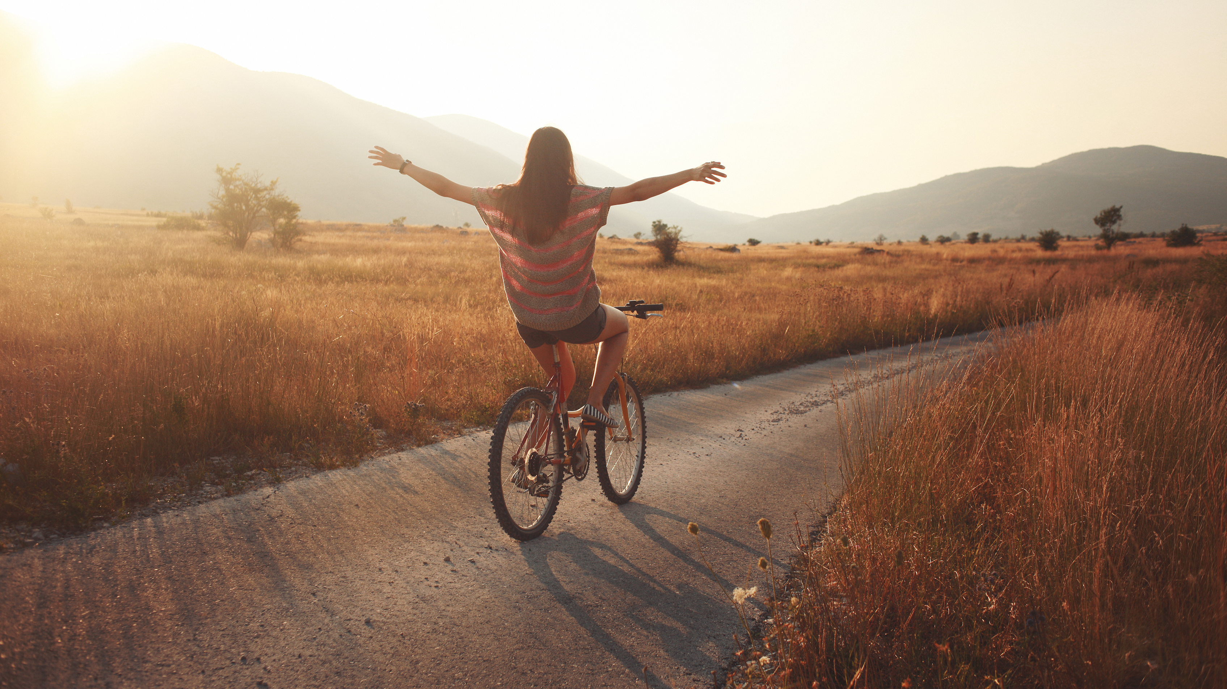
Gratitude as a pathway to improved wellbeing

Slide 11
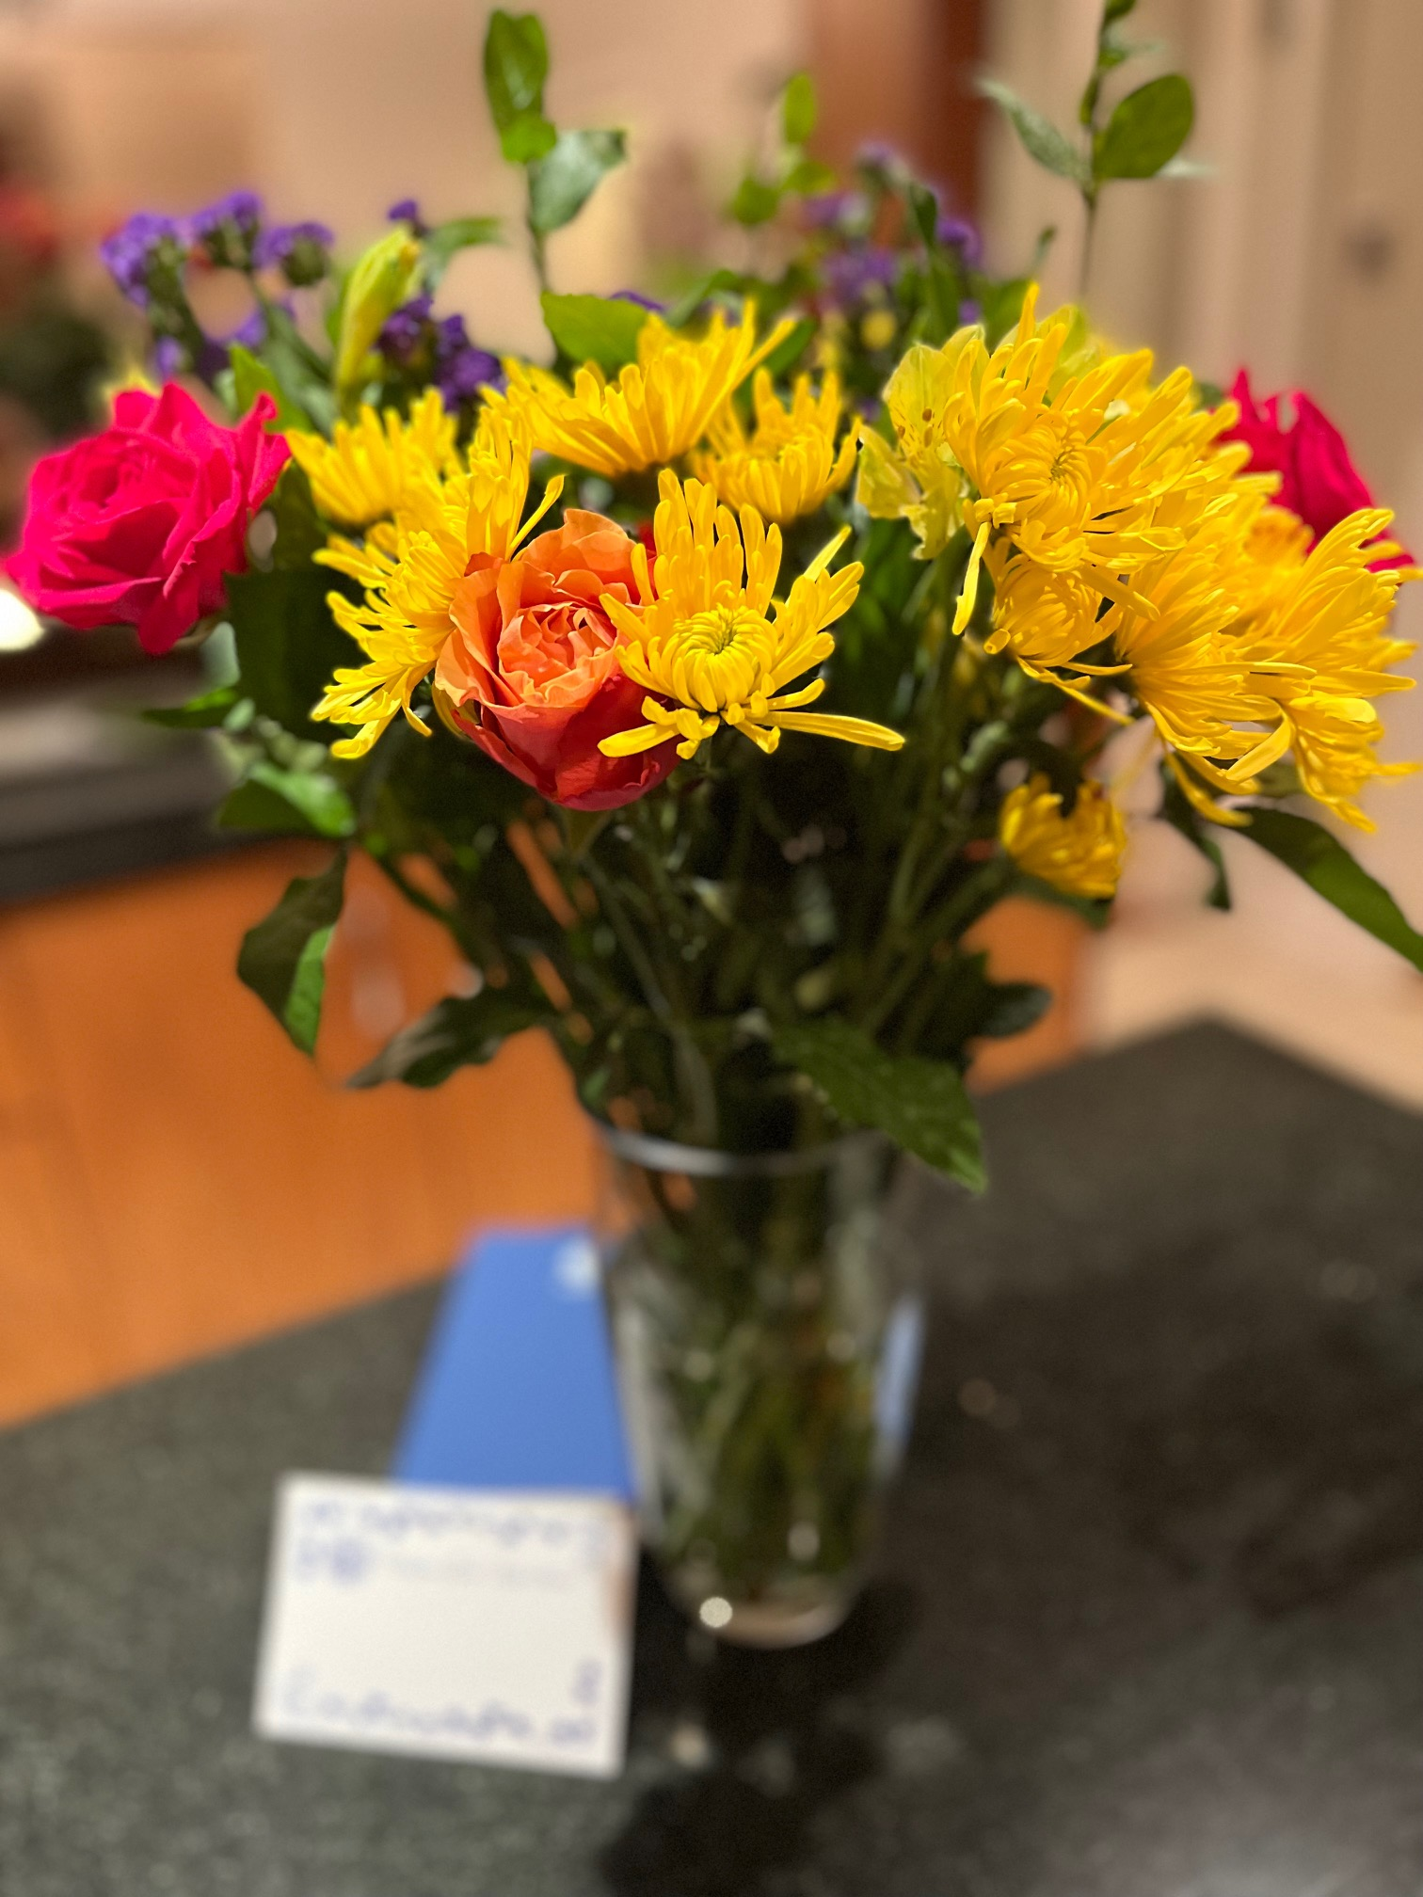
So many studies on the power of GRATITUDE
Positive emotions like gratitude can make you feel more open, creative, and energized
Gratitude has been linked to physical health outcomes
Gratitude can help strengthen relationships
People who feel and express gratitude more often tend to feel happier overall.

Slide 12

Expressing gratitude
Professionally, what are you grateful for?

Slide 13


Three Blessings
Well-known Positive Psychology Exercise

Slide 14
POSITIVE EDUCATION
What was your first impression?

Slide 15

Positive Psychology Goal?
Build (and measure) human flourishing or wellbeing

Slide 16

Positive Education is a philosophy
It is
  a way of organising a school
  a way of conducting lessons
  a way of interacting
  exploring education together
First and foremost a philosophy

Slide 17
Grounded firmly in Science
Draws together research from Positive Psychology, Neuroscience, Social & Emotional Learning
Equips learners and staff to engage wholeheartedly with proactive practices
Strengthen community wellbeing (fundamental aim)

Slide 18

Placing wellbeing at the heart of the school
So much is already happening at your school
Consider what is in place and working well
Play to what is strong

Slide 19

Imagine a classroom …

Slide 20
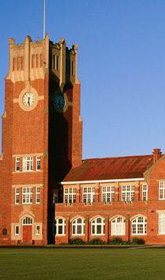
The Story of Geelong Grammar School
In 2008, a ‘revolutionary’ question was posed

Slide 21
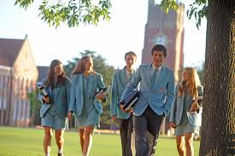
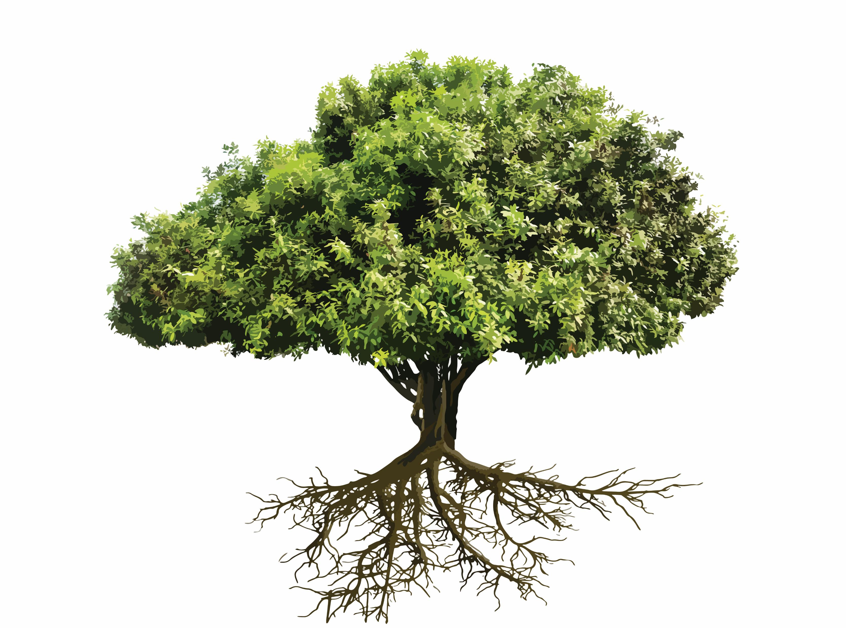
What if the primary goal of education was not just academic success, but the flourishing of every student?

Slide 22
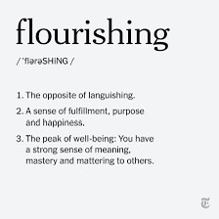

Slide 23
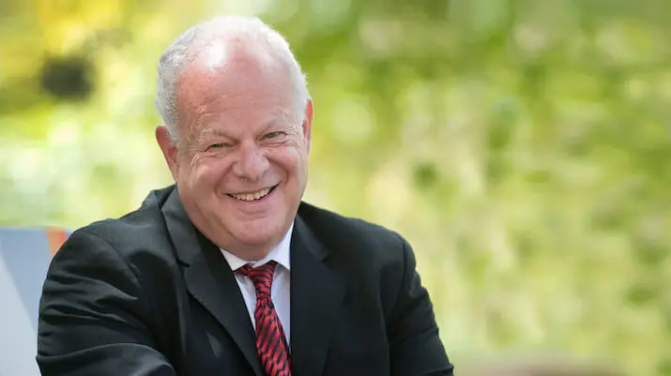
Martin Seligman

Slide 24
Imagine …
Bringing together the science of positive psychology with best practice teaching to encourage and support schools and individuals within their communities to flourish (Jacolyn Norrish et al, 2013)
This is the power of Positive Education

Slide 25
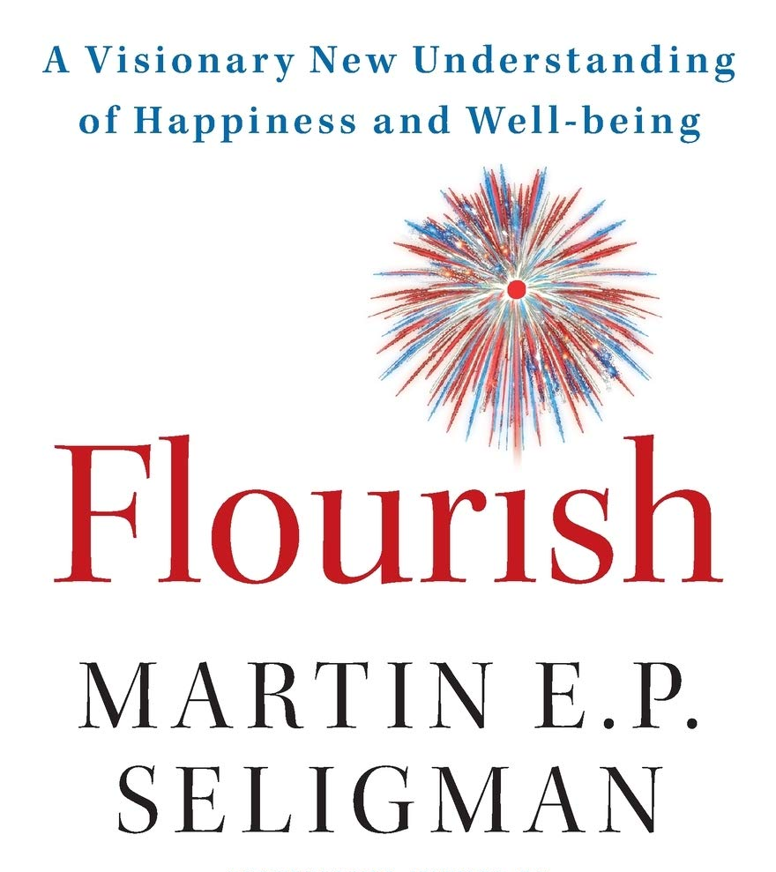
Positive psychology
Theory of well-being
Notes:
The gold standard for measuring well-being is flourishing, and the goal of positive psychology is to increase flourishing.
Martin Seligman published a book in called ‘ FLOURISH’ . Lots of gems in this one!
Director of the Positive Psychology Center ;Professor of Psychology at the University of Pennsylvania.
Dr. Martin E.P. Seligman co-founded the field of positive psychology, and has devoted his career since then to furthering the study of positive emotion, positive character traits, and positive institutions. Most recently Dr. Seligman has started working on Prospective Psychology: researching how thinking about the future shapes present and future behavior.
Martin Seligman is a leading authority in the fields of Positive Psychology, resilience, learned helplessness, depression, optimism and pessimism. He is also an expert on interventions that prevent depression, and build strengths and well-being. He has written more than 250 scholarly publications and more than 20 books

Slide 26
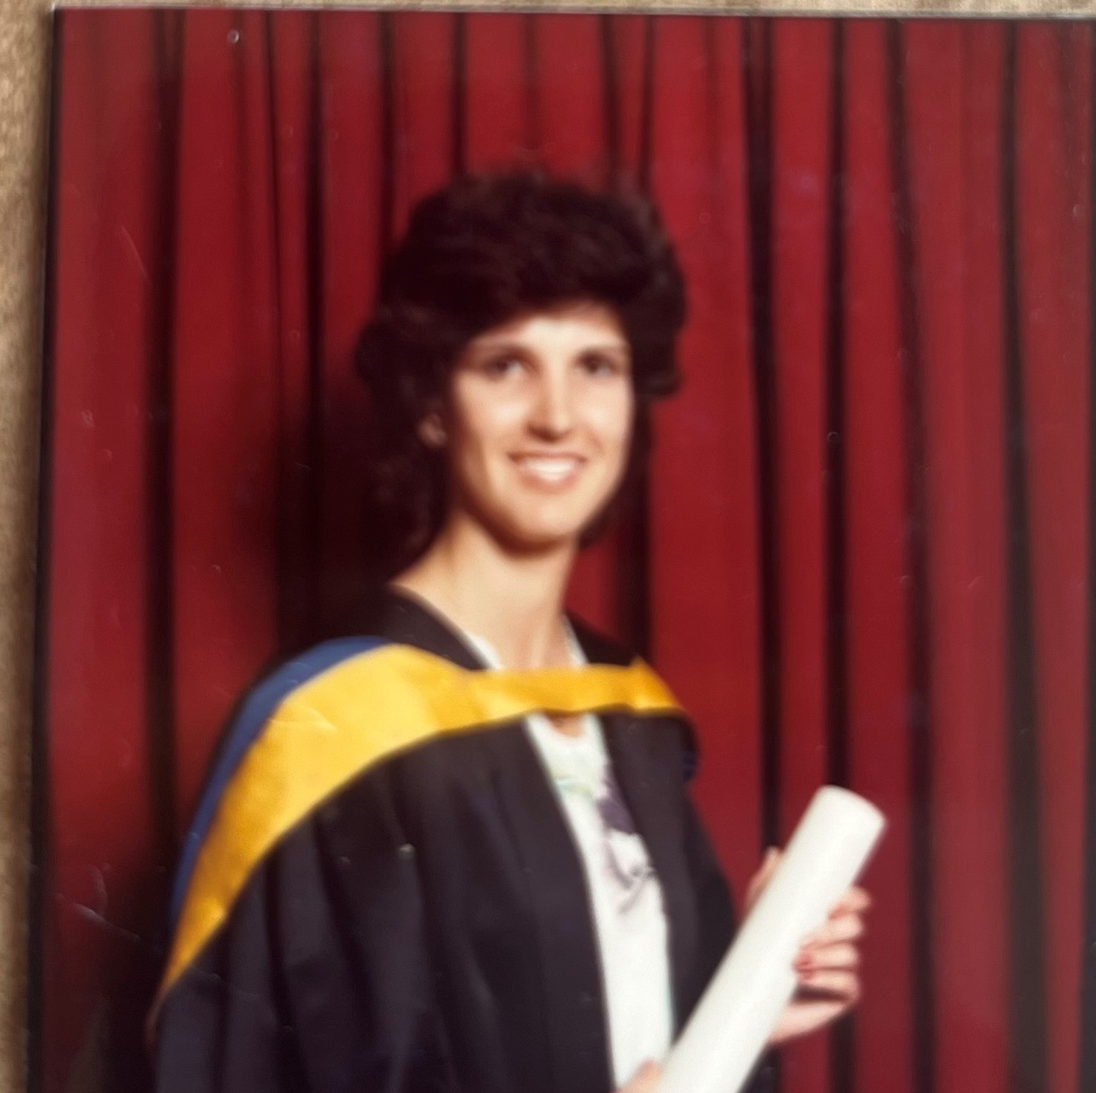
Psychology in the ‘80s
Focused on misery and suffering
Focused on fixing what was wrong
Focused on moving people from minus 5 to zero
Focused on fixing what was wrong
Focused on getting people from minus 10 to 0
Focused on fixing what was wrong
Focused on getting people from minus 10 to 0

Slide 27
Martin Seligman
APA president in 1998
What makes life worth living?
How can people feel good and function well?
What if we were to focus on moving people from 0 to plus 5?
What if we were to focus on what is strong rather than what is wrong?
What will it take to help people to flourish and thrive rather than simply survive?

Slide 28
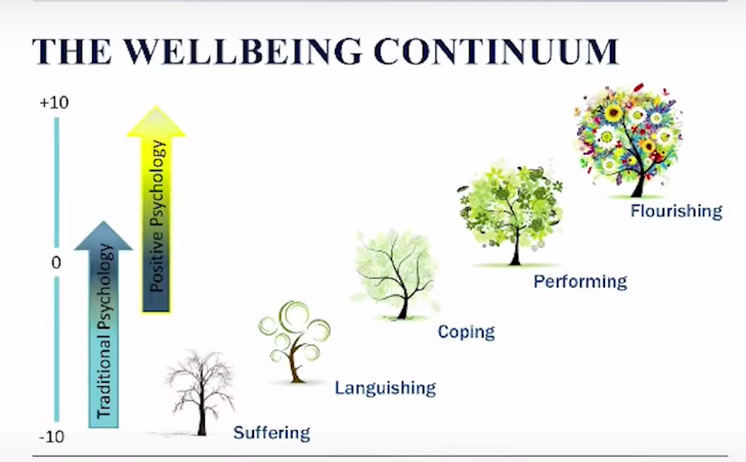

Slide 29

Let’s hear more …

Slide 30
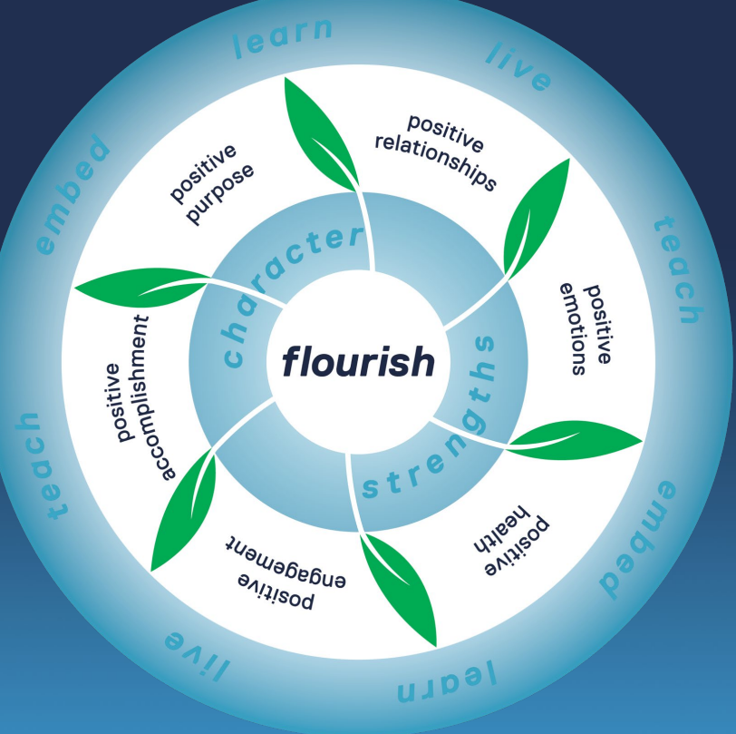
Positive Education Framework at GGS
PERMA model
Health
Character Strengths
LIVE LEARN TEACH EMBED

Slide 31
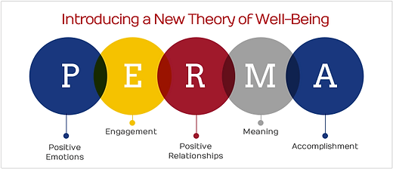

Slide 32
Wellbeing theory
Measures: positive emotions, engagement, meaning, positive relationships, and accomplishment (PERMA)
Goal: increase FLOURISHING by increasing PERMA
Notes:
In positive psychology, flourishing is “to live within an optimal range of human functioning, one that connotes goodness, generativity, growth, and resilience.”^{[1]}Flourishing is the opposite of both pathology and languishing, which are described as living a life that feels both hollow and empty

Slide 33


Slide 34
Positive Education Mantra
Learn
Live
Teach
Embed

Slide 35
LEARN IT!
Understand and engage with the science of wellbeing
Professional learning for staff is helpful

Slide 36
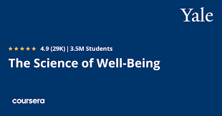
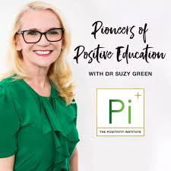
Find out more
The Pioneers of Positive Education Podcast
The Science of Wellbeing
  Most popular class in Yale University's history
  Free
  More than 4.6 million people enrolled
  One of the most successful online courses in history
Institute of Positive Education

Slide 37
LIVE IT!
Live out wellbeing strategies
Not only a programme
Way of being
Cultural change

Slide 38
LEARNER WELLBEING BEGINS WITH TEACHER WELLBEING
Starting with self
Experiencing the practices of positive psychology (keeping a gratitude journal; writing a gratitude letter; practising mindfulness; high quality connections; active and constructive responding; learning about character strengths and a strengths-based approach)
Understanding and engaging with the science of wellbeing

Slide 39
TEACH IT!
Provide learners with dedicated time to discover and explore key domains of wellbeing (curriculum)
Teach the skills and strategies
Plan and programme opportunities during class to enhance wellbeing

Slide 40
EMBED IT!
Make wellbeing an inherent part of school
Adopting long term, school wide policies and practices which support and nurture wellbeing within individuals and within the community

Slide 41
Wellbeing Science/ Positive Psychology
Summed up in THREE words:
OTHER PEOPLE MATTER
- Chris Peterson

Slide 42
CREATING WELLBEING CLASSROOMS
What might that look like in daily interactions?
How can our classrooms become ‘wellbeing classrooms’?
How can we ensure that learners are being given tools to live life well?

Slide 43

A Strengths-Based Approach

Slide 44
Do we…?
Think more about our weaknesses and how we can fix them?
Think about our strengths and build on what is working?

Slide 45
Playing to what is strong
Research suggests that when people spend more time using their strengths and talking about them, they get excited and energised (Cooperrider, 2012).
So, why not try to identify your character strengths?
What are CHARACTER STRENGTHS?

Slide 46

Character Strengths
Character Strengths are the positive parts of your personality that impact how you think, feel and behave.
Character strengths are different from your other personal strengths, such as your unique skills, talents, interests and resources, because they reflect the "real" you—who you are at your core.
These strengths are the key to being your best self.

Slide 47

Character Strengths Handbook
In 2004 Martin Seligman and Chris Peterson edited a ground-breaking book: Character Strengths and Virtues: A Handbook and Classification.
In that book, the authors undertook a systematic classification and measurement of universal virtues and strengths.
They identified 6 virtues comprising of 24 measurable positive character strengths

Slide 48

Martin Seligman on the importance of character strengths

Slide 49

Take the survey when you get a chance!
Why take the survey?
Millions of people have taken the free VIA survey to discover their greatest strengths so they can use them in their everyday lives. Research shows that using your character strengths can help you:
  Improve your relationships
  Enhance your overall wellbeing
  Build your resilience
  Strengthen your ability to overcome problems
www.viacharacter.org

Slide 50
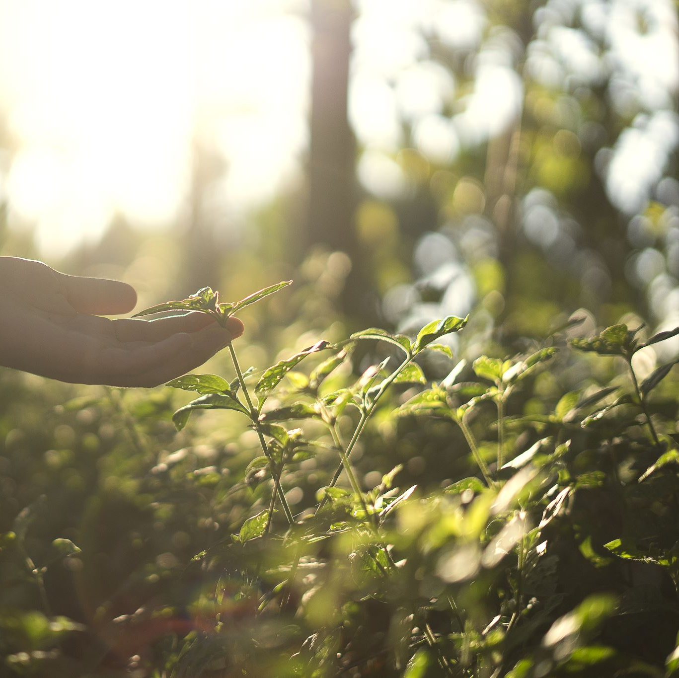
What we focus on grows

Slide 51

Wellbeing Literacy
Start with strengths (www.viacharacter.org)
Learn the language
Learn to speak the language (strengths spotting)
Strengths-building & strengths-spotting

Slide 52
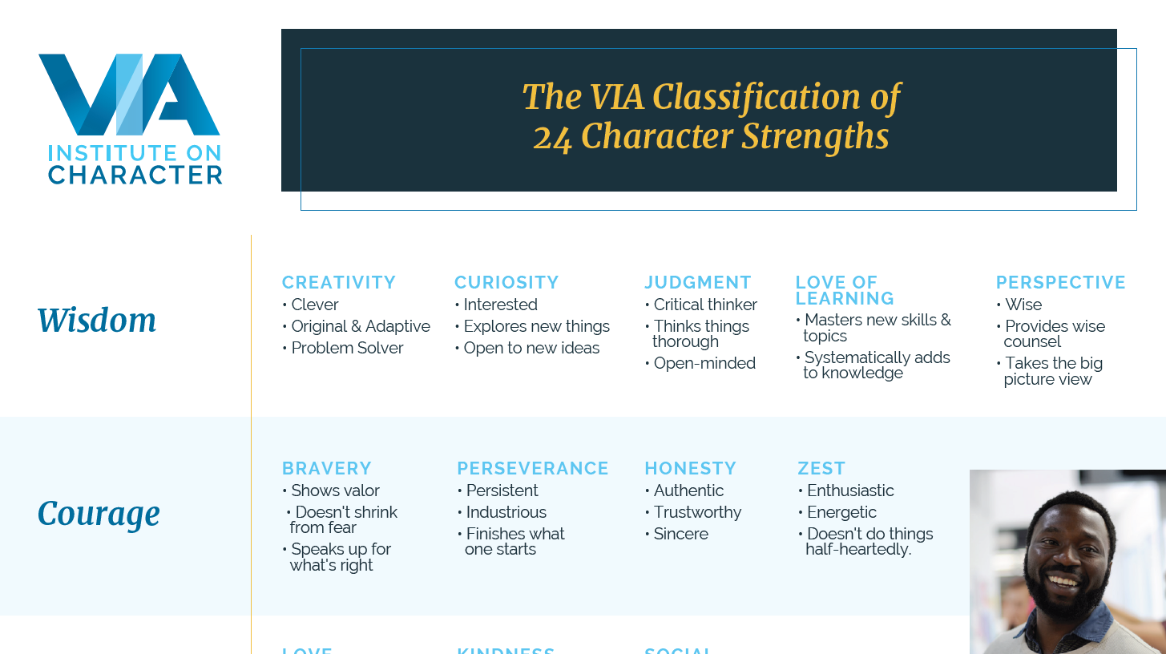

Slide 53
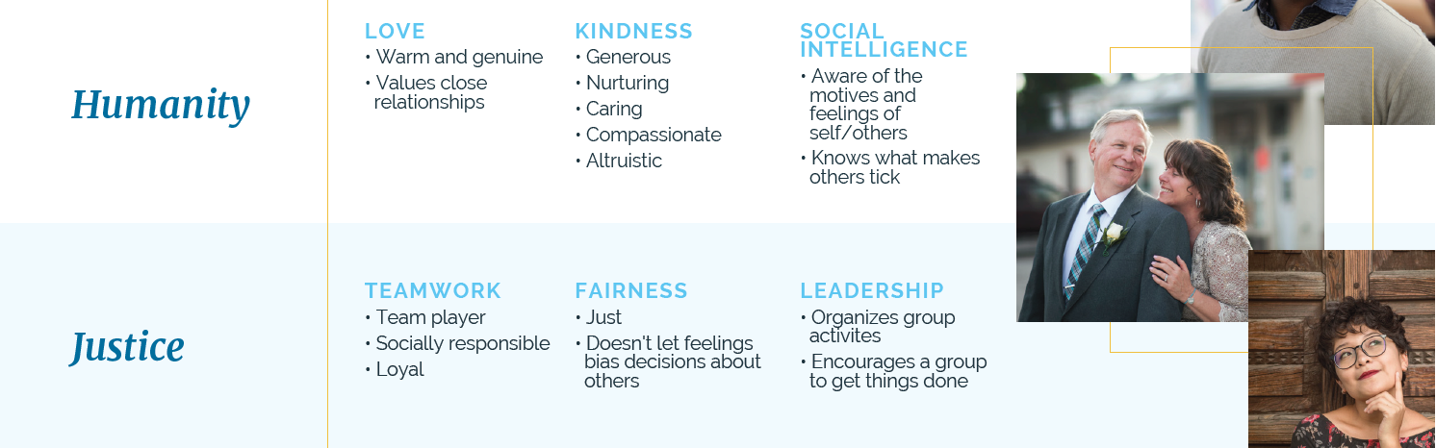

Slide 54
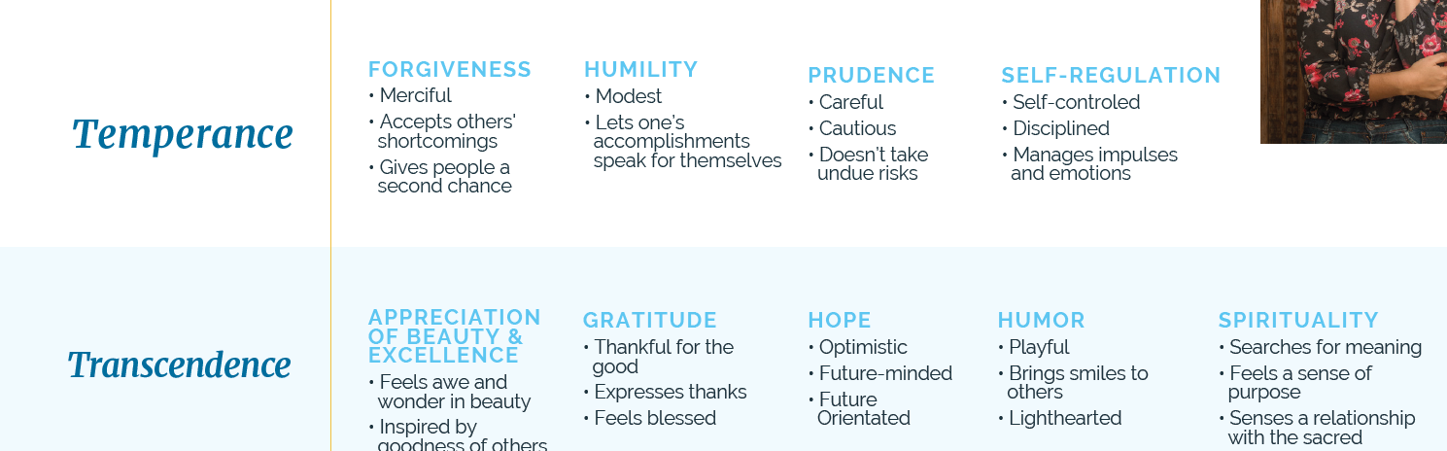

Slide 55


Reflecting on character strengths

Slide 56
Engaging using character strengths

Slide 57

Play to what is strong not what is wrong

Slide 58
Little things make a big difference
In the world of Positive Psychology, we know that even the smallest things that can make the biggest difference – that the mindful investment of a tiny positive gesture today can pay huge dividends on the strength and resilience of a relationship in the future and in turn on our own and others’ capacity to flourish.
- Clive Leach

Slide 59

Putting it all together
Wellbeing interventions are most effective when using a whole-school approach
Philosophy needs to be infused
Support staff to the principal
Intentional and strategic
Not a one-size-fits all

Slide 60
Positive Education / Wellbeing Education
Pro-active approach
Whole-school approach
Strengths-based approach
Evidence-based approach

Slide 61

What Positive Education is not
… about being happy all the time
… about ensuring a child is free from adversity and failure
… not a ‘one-size-fits-all’ approach
… just another programme

Slide 62
In summary …
It brings together the science of positive psychology with best practice teaching to encourage and support schools and individuals within their communities to to flourish .
(Jacolyn Norrish et al, 2013)

Slide 63

One looks back with appreciation to the brilliant teachers, but with gratitude to those who touched our human feelings.
The curriculum is so much necessary raw material, but warmth is the vital element for the growing plant and for the soul of the child.
- Carl Jung

Slide 64
Good teachers we remember
Those who touch our humanity, we’ll never forget.
- Carl Jung

Slide 65
Thank you for listening and participating!
Enjoy the conference ☺

